Slide 1
Indirect Visual Odometry with Optical Flow
Chenguang Huang, Andong Tan
München, 22. July 2019

Slide 2
Overview
1. Introduction
1.1 Lukas Kanade Method for Optical Flow
1.2 Project Pipeline
1.3 Parameter and strategy
2. Result
2.1 Precision Comparison
2.2 Execution Time Comparison
2.3 Visualization Comparison
3. Conclusion

Slide 3
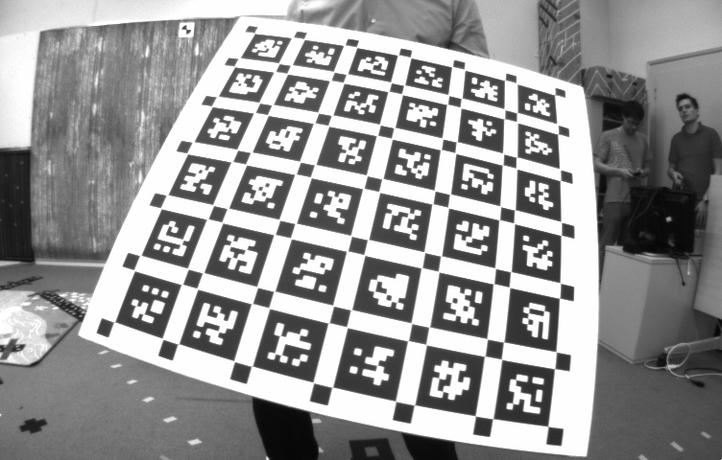
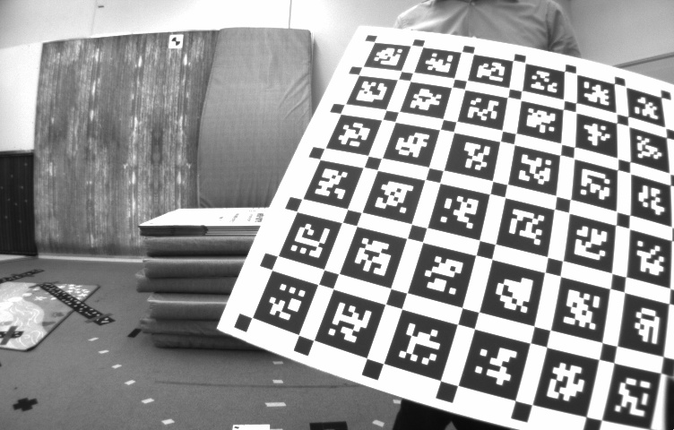
1 Introduction
1.1 Lukas Kanade method for optical flow
Input: two images, key points in one image
Output: the key points in the other image(the motion of the key points).
Input key point position in one image
Output key point position in the other image

Slide 4
1 Introduction
1.1 Lukas Kanade method for optical flow
Inspiration in SLAM:
replace feature descriptors matching with optical flow method!
Input key point position in one image
Output key point position in the other image

Slide 5
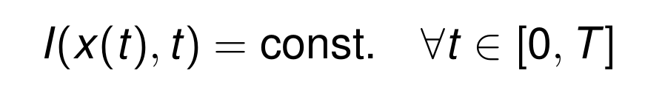
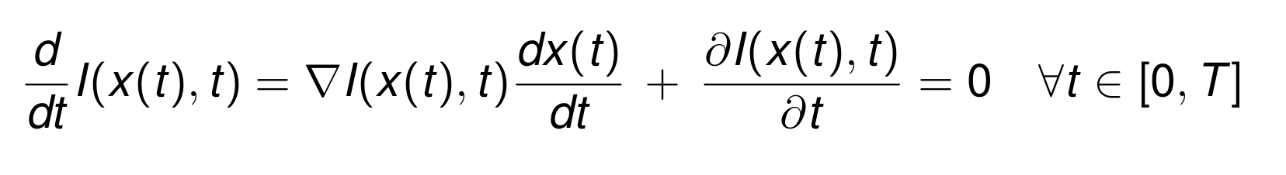
1 Introduction
1.1 Lukas Kanade method for optical flow
Basic mathematical principle
A method to estimate the motion of object in image. It is based on one assumption:
the brightness of a moving point remains constant over time
Derivative with respect to time

Slide 6
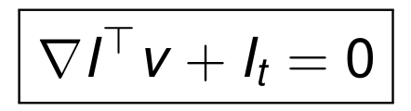
1 Introduction
1.1 Lukas Kanade method for optical flow
Solve this function for v

Slide 7
1 Introduction
Keypoints detection in every key frame:
yes
Keyframe?
no
First image?
……
yes
no
1 Key points detection in left image
2 Calculate key points in right image according
to left image (OF)
3 Compute essential matrix, find inlier
4 Localize camera
5 Initialize landmarks
1 Calculate key points in left image
according to left image in last time step (OF)
2 Separate the left image into cells and detect
new points in empty cells
3 Calculate the keypoints in right image (OF)
according to left image
4 Compute essential matrix and find inlier
5 Localize camera
6 Create new landmarks
7 Optimization
(8 frame-frame triangulation)

Slide 8
1 Introduction
Use optical flow and keypoints detection in key frame:
yes
Keyframe?
no
First image?
1 Calculate key points in left image
according to left image in last time step (OF)
2 Separate the left image into cells and
calculate the number of empty cells
3 (no calculation of essential matrix)
Because no relative pose between frame
4 Localize camera
6 If not enough key points or inliers or
too many empty cells && optimization is not
running and not finished, set the next frame
as key frame
……

Slide 9
1 Introduction
1.2 Project pipeline: first key frame
Step 1: detect key points in left image
Left image
Right image
Time 0

Slide 10
1 Introduction
1.2 Project pipeline: first key frame
Step 2: use optical flow to get corresponding key points in right image
Left image
Right image
.
.
.
Time 0

Slide 11
1 Introduction
1.2 Project pipeline: first key frame
Step 3: check epipolar constraint and find inlier
Left image
Right image
Time 0

Slide 12
1 Introduction
1.2 Project pipeline: first key frame
Step 4: localize camera(initialize the first left camera pose with identity matrix)
Left image
Right image
Time 0

Slide 13
1 Introduction
1.2 Project pipeline: first key frame
Step 5: triangulate landmarks
…...
Left image
Right image
Time 0

Slide 14
1 Introduction
1.2 Project pipeline: second and later key frame
Step 1: use optical flow to get corresponding key points last time step of left frame
Left image
Right image
Time t-1
Time t

Slide 15
1 Introduction
1.2 Project pipeline: second and later key frame
Step 1: use optical flow to get corresponding key points last time step of left frame(backward check)
Left image
Right image
Time t-1
abandon
Time t

Slide 16
1 Introduction
1.2 Project pipeline: second and later key frame
Step 2: make grid in left image and detect key points in empty cells
Left image
Right image
Time t-1
Empty cells
Time t
Detect new
key points

Slide 17
1 Introduction
1.2 Project pipeline: second and later key frame
Step 3: use optical flow to find the corresponding key points in the right image
Left image
Right image
Time t-1
Newly detected
Compute from last frame
Time t

Slide 18
1 Introduction
1.2 Project pipeline: second and later key frame
Step 4: use epipolar constraint to find inliers
Left image
Right image
Time t-1
Inliers
Time t

Slide 19
1 Introduction
1.2 Project pipeline: second and later key frame
Step 5: localize camera
Left image
Right image
Time t-1
Use the key
points that
already has
landmarks
to localize
camera
Time t

Slide 20
1 Introduction
1.2 Project pipeline: second and later key frame
Step 6: add observation and create landmarks
Left image
Right image
Time t-1
Add observation
Create new
landmarks
Time t

Slide 21
1 Introduction
1.2 Project pipeline: non key frame
Step 1: use optical flow to get corresponding key points last time step of left frame
Left image
Right image
Time t-1
Time t

Slide 22
1 Introduction
1.2 Project pipeline: second and later key frame
Step 2: make grid in left image and count the number of empty cells
Left image
Right image
Time t-1
# of empty cells
Time t
Don’t detect new
key points

Slide 23
1 Introduction
1.2 Project pipeline: second and later key frame
Step 2: make grid in left image and count the number of empty cells
Left image
Right image
Key framing strategy
Time t-1
# of empty cells
If greater than
threshold, make
next frame
key frame
Time t

Slide 24
1 Introduction
1.2 Project pipeline: second and later key frame
Step 5: localize camera
Left image
Right image
Time t-1
localize
camera
Time t

Slide 25
1 Introduction
1.3 Parameter and strategy
1.3.1 Grid shape: retangle vs square
pixel x pixel
30 x 47
32 x 32
rmse
0.14
0.11

Slide 26
1 Introduction
1.3 Parameter and strategy
1.3.2 Key points detection: in whole image vs in each cell
Detect in whole image
Detect in empty cells respectively
Then only keep key points in empty cells
rmse
0.1139
0.1116

Slide 27
1 Introduction
1.3 Parameter and strategy
1.3.3 Key framing: use grid vs use only inliers number
# of empty cells
# of localization inliers
If greater than
threshold, make
next frame
key frame
If smaller than
threshold, make
next frame
key frame
rmse
0.11
0.43

Slide 28
2 Result
2.1 Precision comparison
Basic parameters
image height (pixel) | image width (pixel) | grid size (pixel x pixel) | Minimum number of key points
480 | 752 | 32 x 32 | 100
Strategy
1. Square grid
2. Add key points in each cell
3. Use empty cells number to decide next key frame

Slide 29
2 Result
2.1 Precision comparison
Variation parameters: maximum empty cells percentage*
Maximum empty cells number | 0.35 | 0.4 | 0.42 | 0.44 | 0.46 | Exercise 5
rmse | 0.1303 | 0.1295 | 0.1099 | 0.1563 | 0.1304 | 0.1012
*maximum empty cells percentage: when the empty cells percentage exceeds this
value and optimization is finished, make next frame key frame

Slide 30
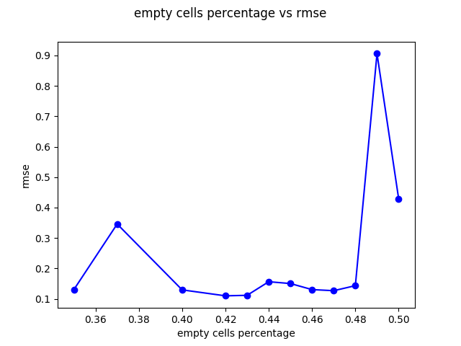
2 Result
2.1 Precision comparison

Slide 31
2 Result
2.2 Execution time comparison
2.2.1 Detection time
Variation parameters: maximum empty cells percentage*
Maximum empty cells number | 0.35 | 0.4 | 0.42 | 0.44 | 0.46 | Exercise 5
detection time (seconds) | 3.03643 | 2.73232 | 2.43286 | 2.62328 | 2.26326 | 44.0214
*maximum empty cells percentage: when the empty cells percentage exceeds this
value and optimization is finished, make next frame key frame

Slide 32
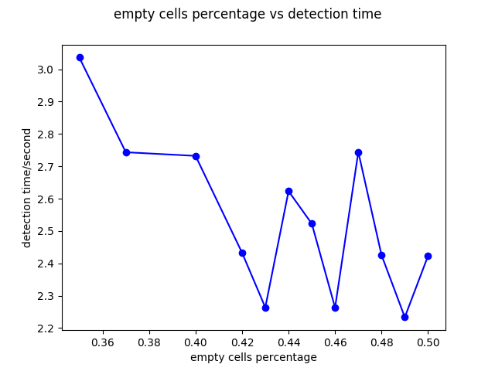
2 Result
2.2 Execution time comparison

Slide 33
2 Result
2.2 Execution time comparison
2.2.2 Optimization time
Variation parameters: maximum empty cells percentage*
Maximum empty cells number | 0.35 | 0.4 | 0.42 | 0.44 | 0.46 | Exercise 5
Opt time (seconds) | 430.423 | 333.723 | 305.043 | 301.82 | 268.572 | 65.8619
# landmarks | 357718 | 306608 | 290657 | 272688 | 257608 | 221886
# observation | 2806876 | 2120591 | 1939460 | 1715910 | 1545726 | 559563
*maximum empty cells percentage: when the empty cells percentage exceeds this
value and optimization is finished, make next frame key frame

Slide 34
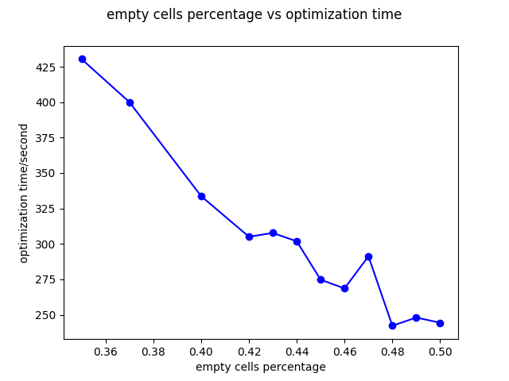
2 Result
2.2 Execution time comparison

Slide 35
2 Result
2.2 Execution time comparison
2.2.3 Frame to frame optical flow time
Variation parameters: maximum empty cells percentage*
Maximum empty cells number | 0.35 | 0.4 | 0.42 | 0.44 | 0.46 | Exercise 5 feature matching time
f2f optical flow time (seconds) | 143.192 | 133.53 | 117.438 | 135.881 | 120.76 | 5.79
*maximum empty cells percentage: when the empty cells percentage exceeds this
value and optimization is finished, make next frame key frame

Slide 36
2 Result
2.2 Execution time comparison

Slide 37
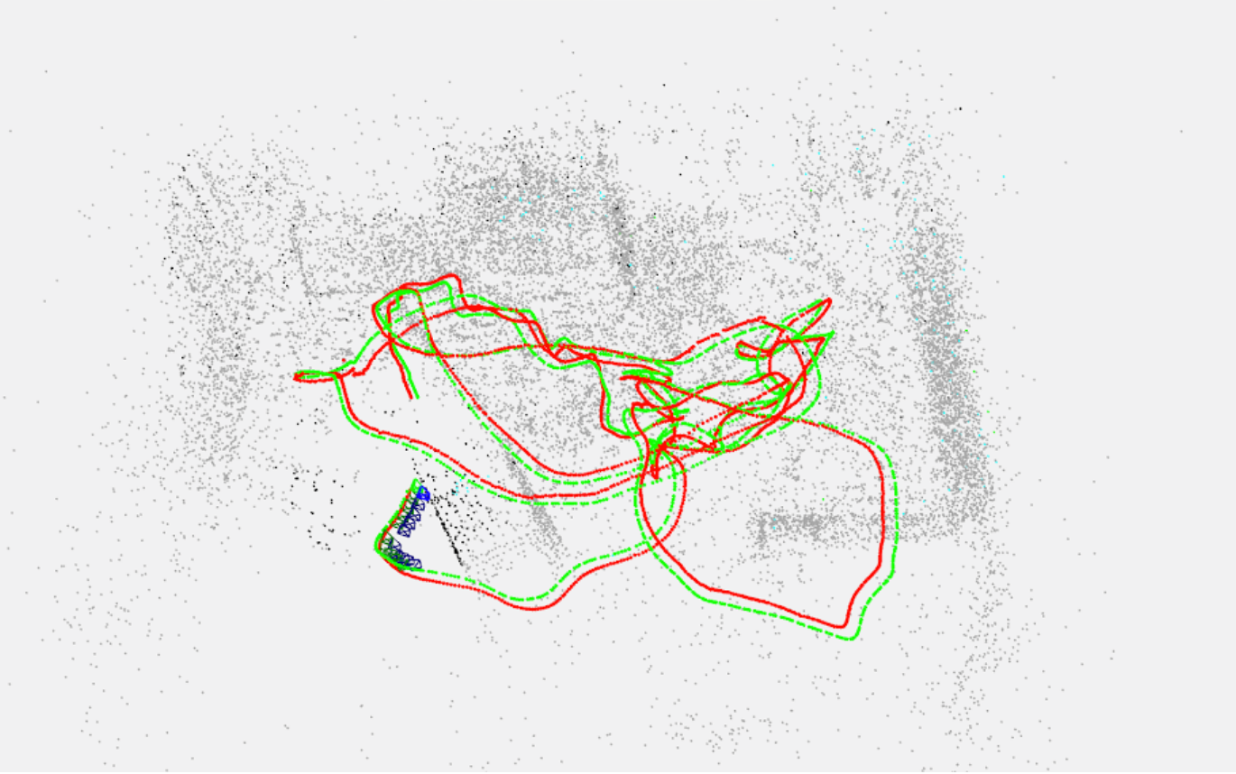
2 Result
2.3 Visualization comparison
Maximum empty cells percentage: 0.42

Slide 38
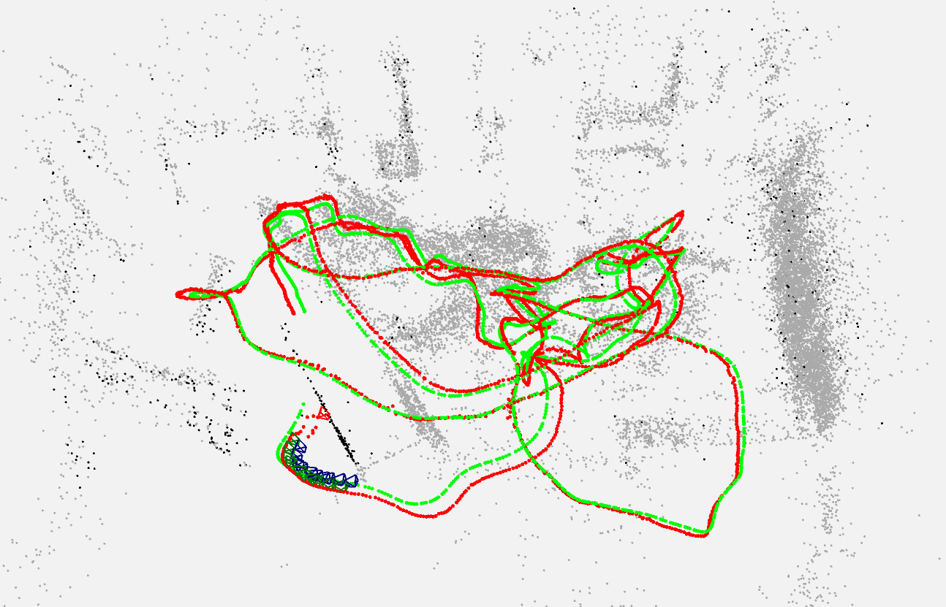
2 Result
2.3 Visualization comparison
Exercise 5

Slide 39
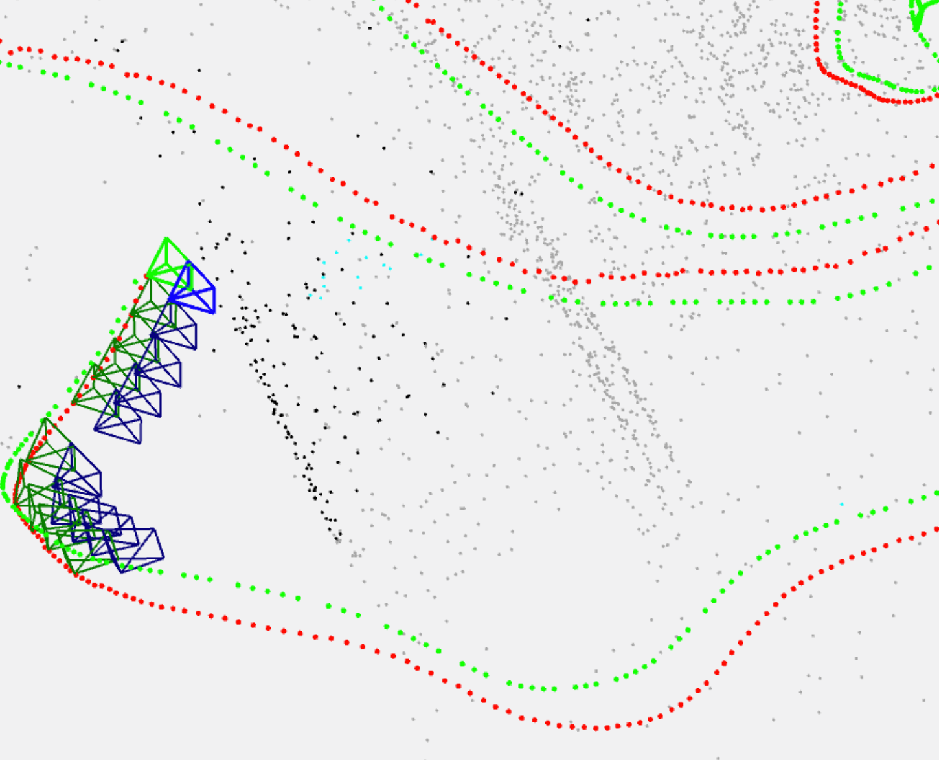
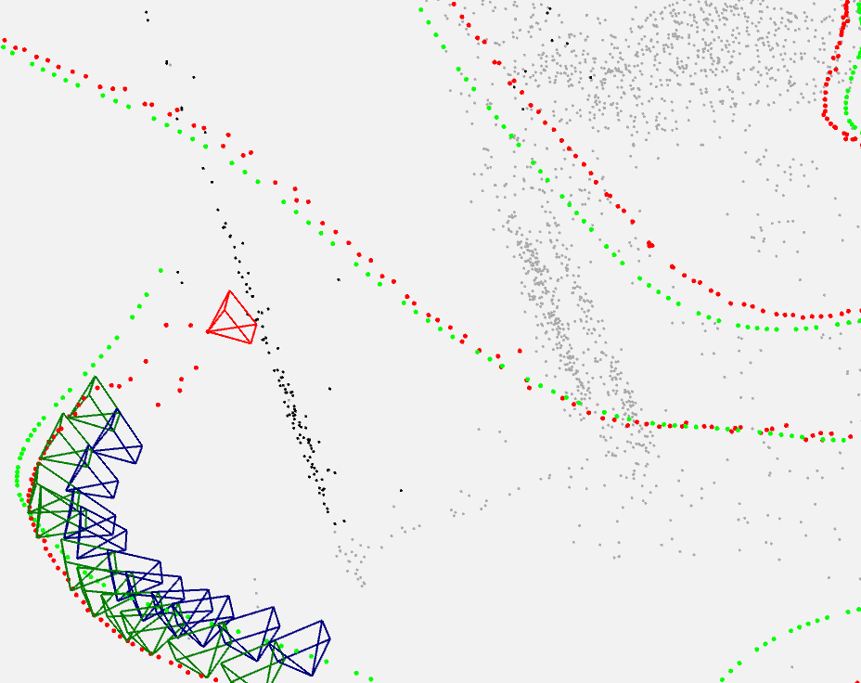
2 Result
2.3 Visualization comparison
Maximum empty cells number: 0.42
Exercise 5

Slide 40
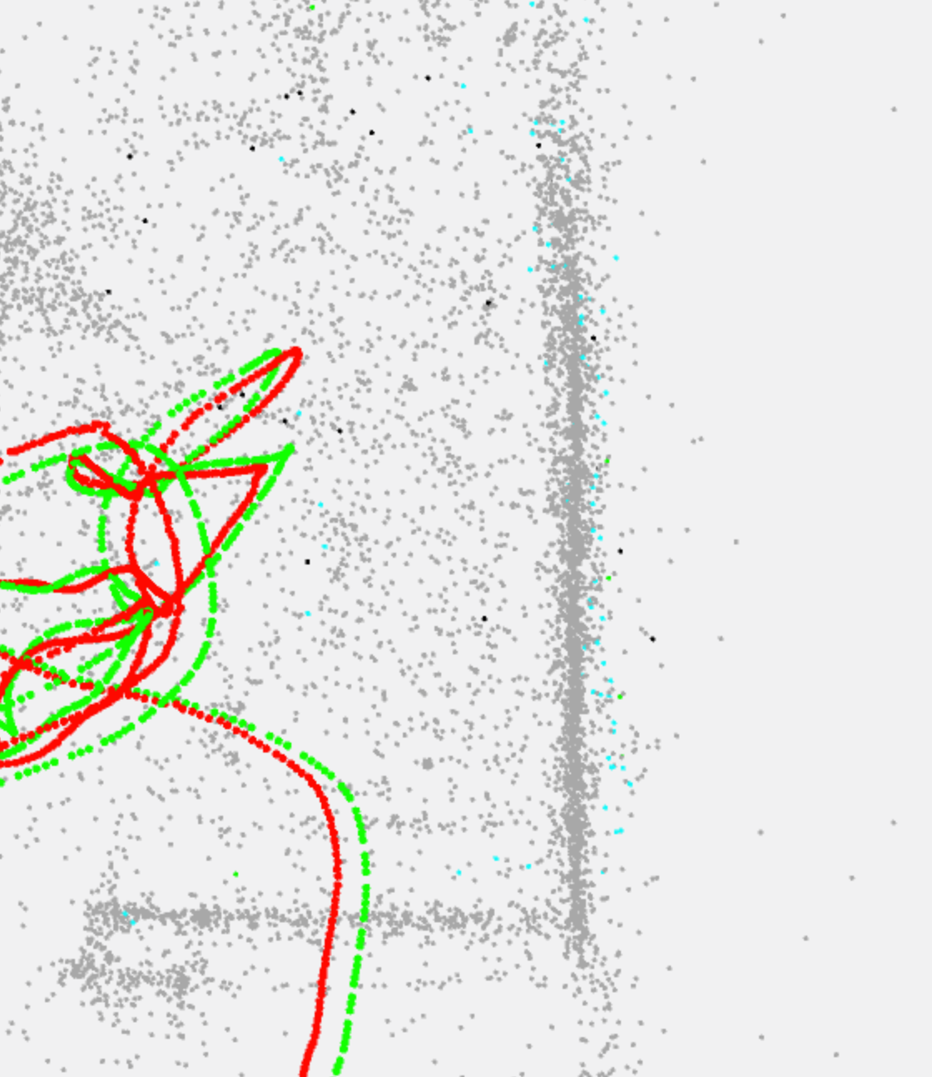
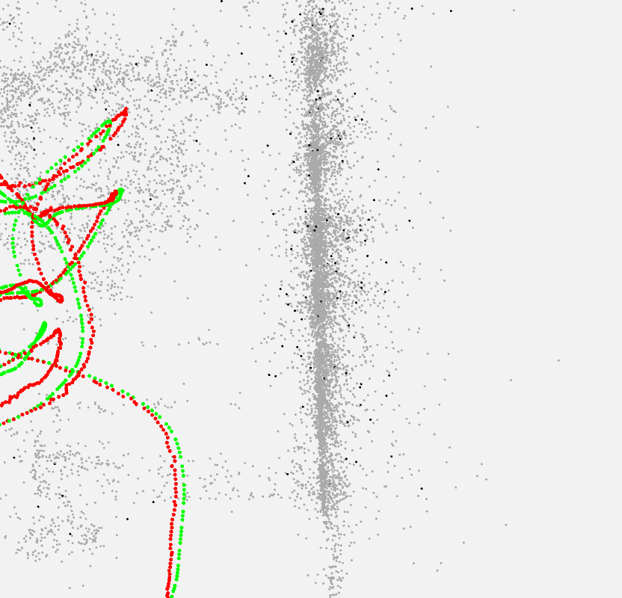
2 Result
2.3 Visualization comparison
Maximum empty cells number: 0.42
Exercise 5

Slide 41
3 Conclusion
What we did in this project:
1. We use Lucas and Kanade Optical Flow method to replace normal feature matching in slam.
2. We try different key framing strategies: use grid or inliers.
3. We try different setups for the pipeline, such as shape of grid, key points detection strategies.
4. We visualize the ground truth and estimated trajectories of camera and do analysis.

Slide 42
3 Conclusion
What we can do in the future:
1. implement optical flow manually, using intensity invariant optical flow to make the pipeline more stable.
2. try to implement frame to frame triangulation: using left images at different time step to triangulate new landmarks.

Slide 43
Q&A
Any question?

Slide 44
Thank you for your attention!

